Slide 1
River Continuum Concept
Bhatt & Whitehouse

Slide 2
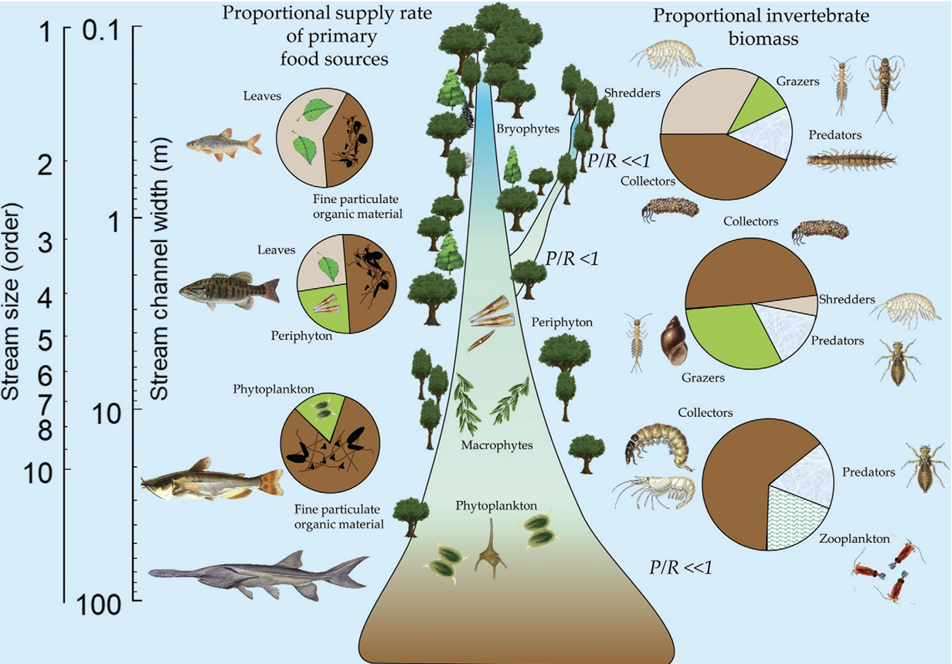
River Continuum Concept
CF
collector-filterer
CG
collector-grazer
PR
predator
SC
scraper
SH
shredder
Dodds W, Maasri A. 2022. The River Continuum Concept. In: Encyclopedia of Inland Waters. Vol. 2. 2nd ed. Elsevier. p. 237–243.

Slide 3
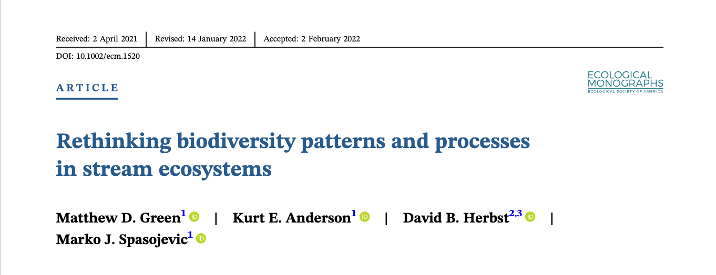
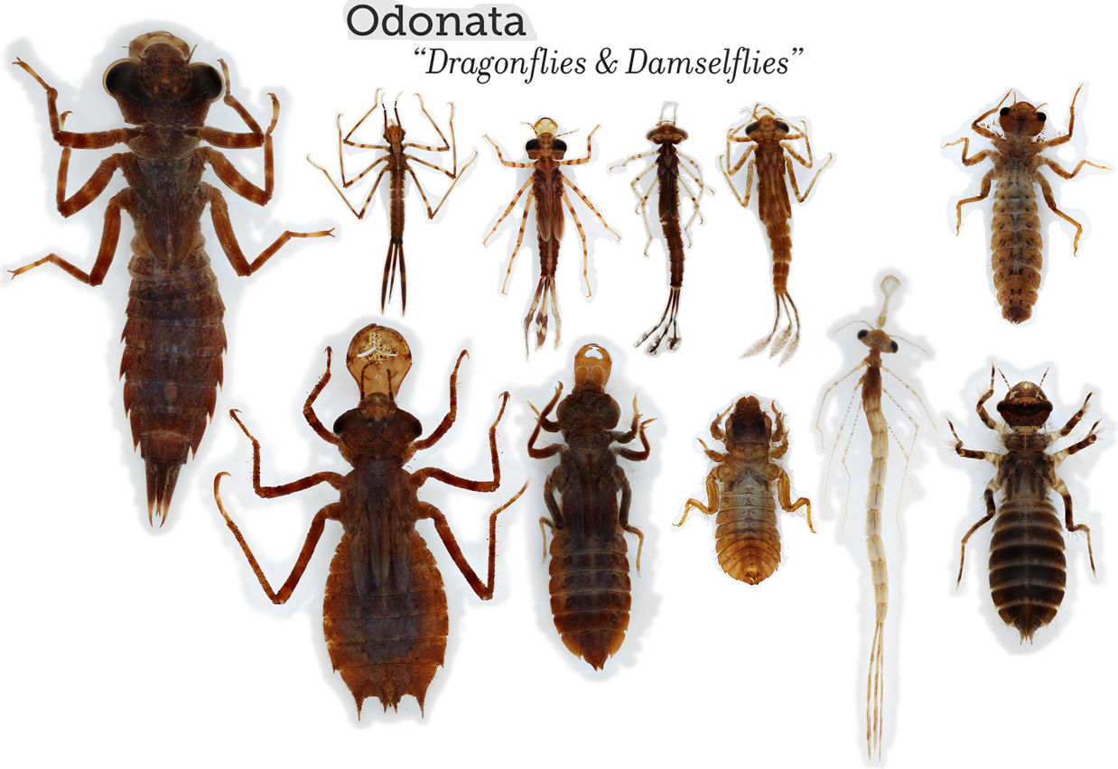
Study: Green et al.
sampled macroinvertebrates in five distinct lake-stream networks in Sierra-Nevada, California

Slide 4
1. Defining Hypotheses

Slide 5
Hypotheses
H₀
No change in macroinvertebrate group abundance along river gradients
Predictions
H₁
Statistically significant change in macroinvertebrate group abundance along river gradients
1
increases in CF, CG and SC between the beginning and end of the river
2
decreases in SH between the beginning and end of the river
3
no change in PR between the beginning and end of the river

Slide 6
2. Exploring Data

Slide 7
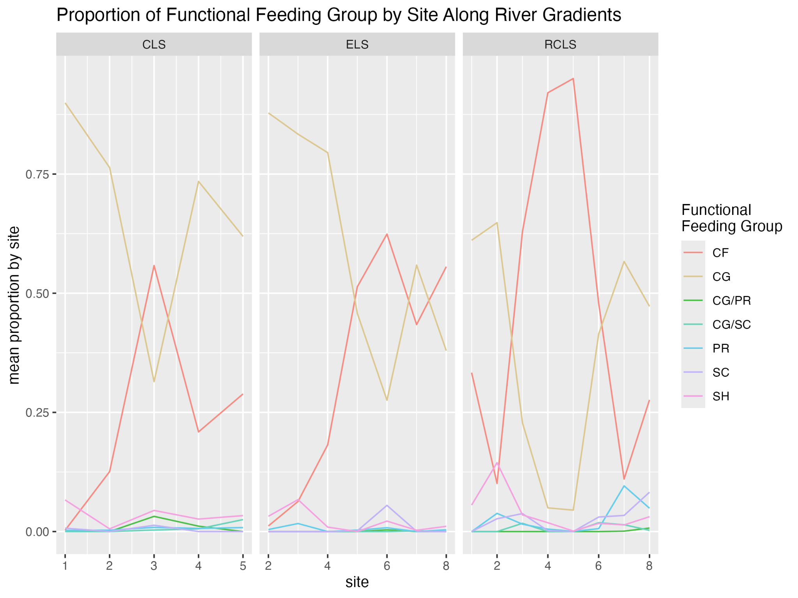
Data Simplification
replaced taxonomic info with functional feeding group (FFG) info
selected linear rivers
CF & CG
replacement in middle of the river

Slide 8
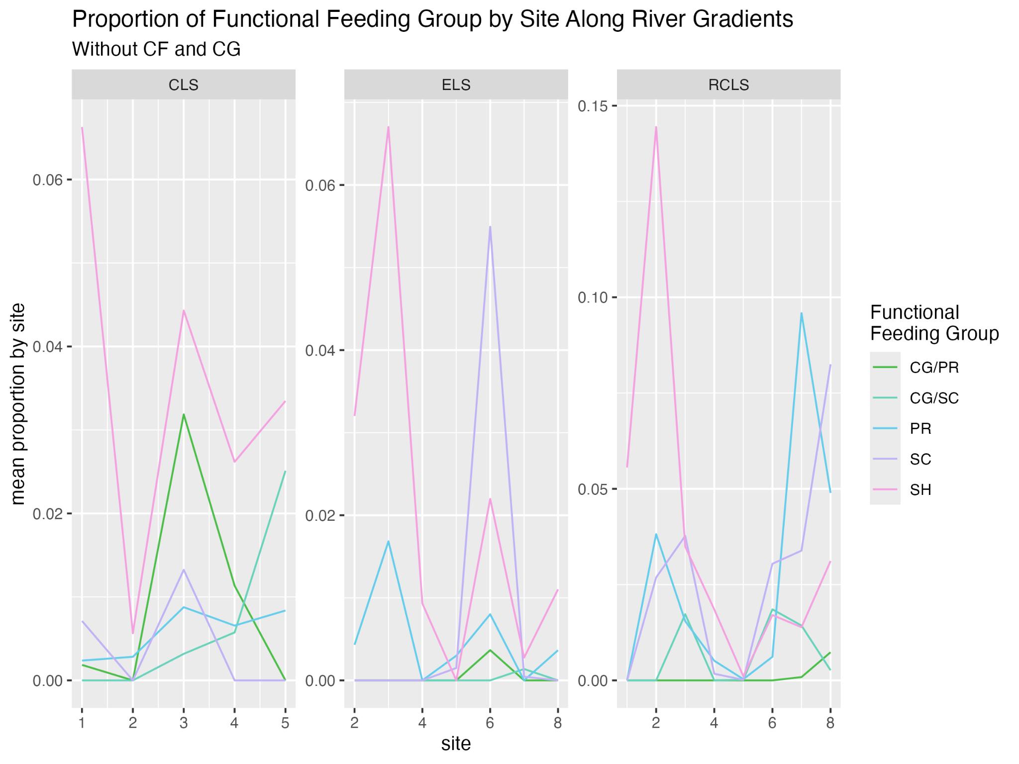
PR
increase with others
SH
peak at beginning (consistent with RCC)
yay :)

Slide 9
3. Grouping Data

Slide 10
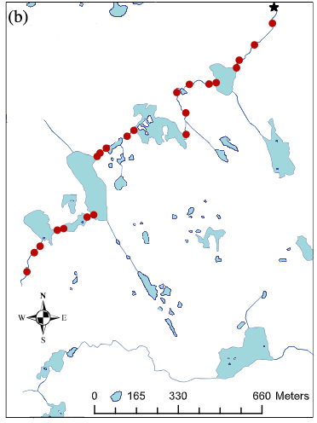
Site Grouping
FFG Grouping
New FFG | Original FFG
beginning
end
CF
CF
CG
CG
CG/PR
CG/SC
PR
PR
CG/PR
SC
SC
CG/SC
SH
SH

Slide 11
4. Testing for Significance

Slide 12
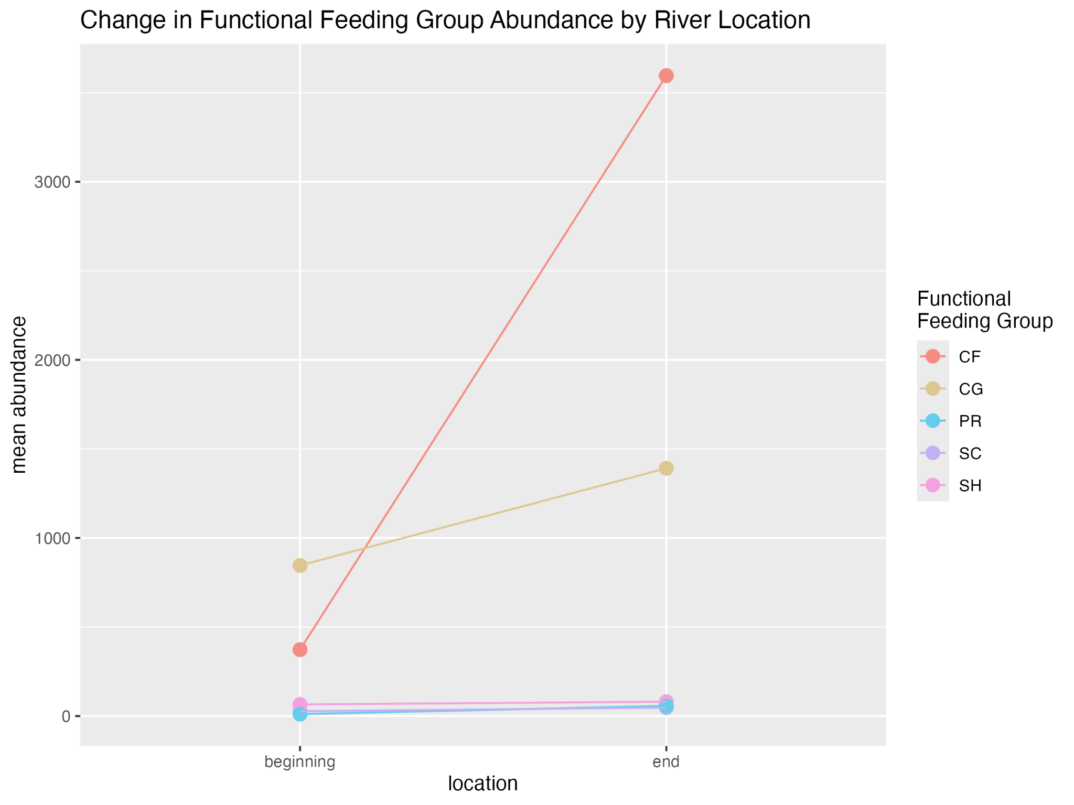
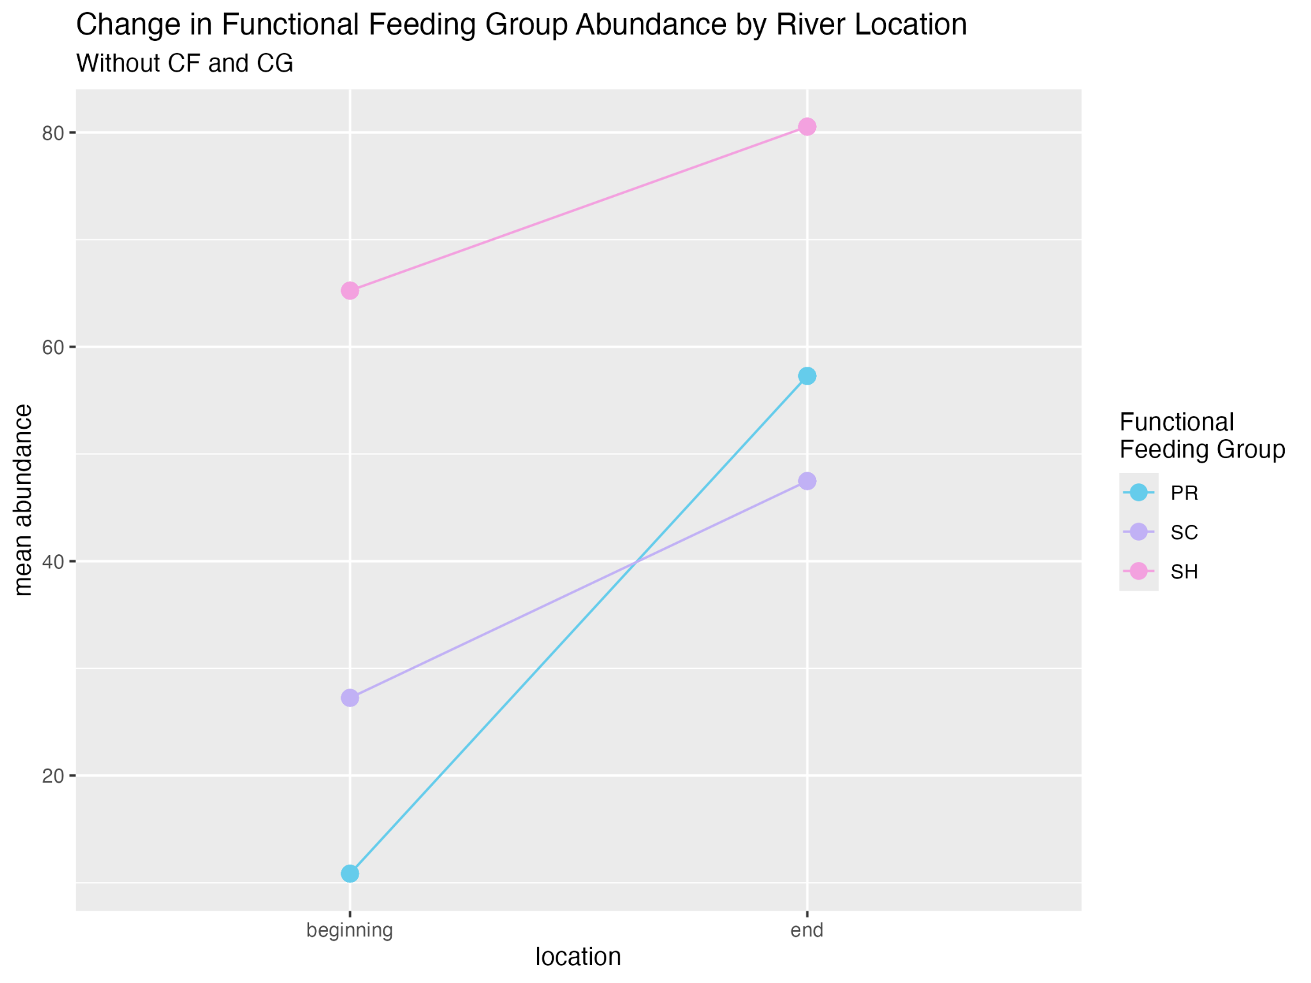
a. Reaction Norms
Predictions:
CF
CG
SC
SH
PR
Results:
✓
✓
✓
x
x

Slide 13
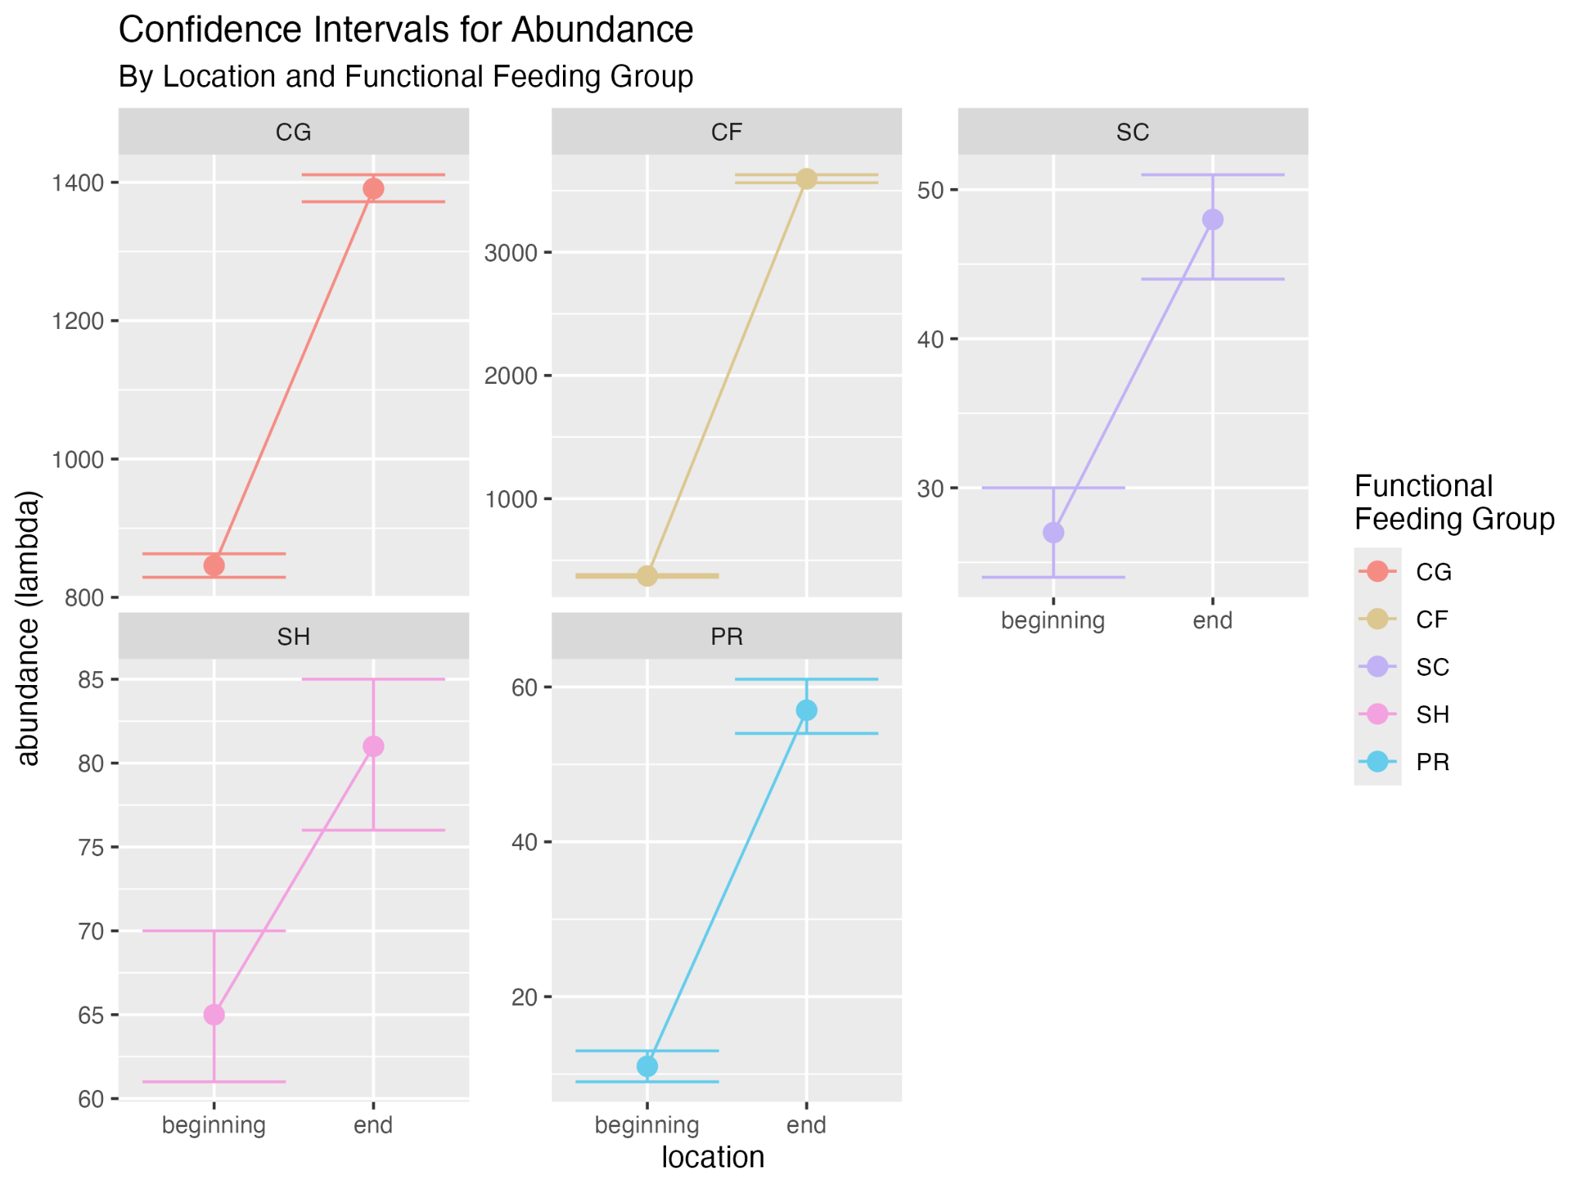
b. Confidence Intervals
steps
likelihood estimation using a Poisson distribution
found the maximum likelihood estimator for each location and FFG
defined confidence intervals based on distance from the maximum likelihood estimator
yay #2 :)

Slide 14
5. Testing Other Distributions

Slide 15
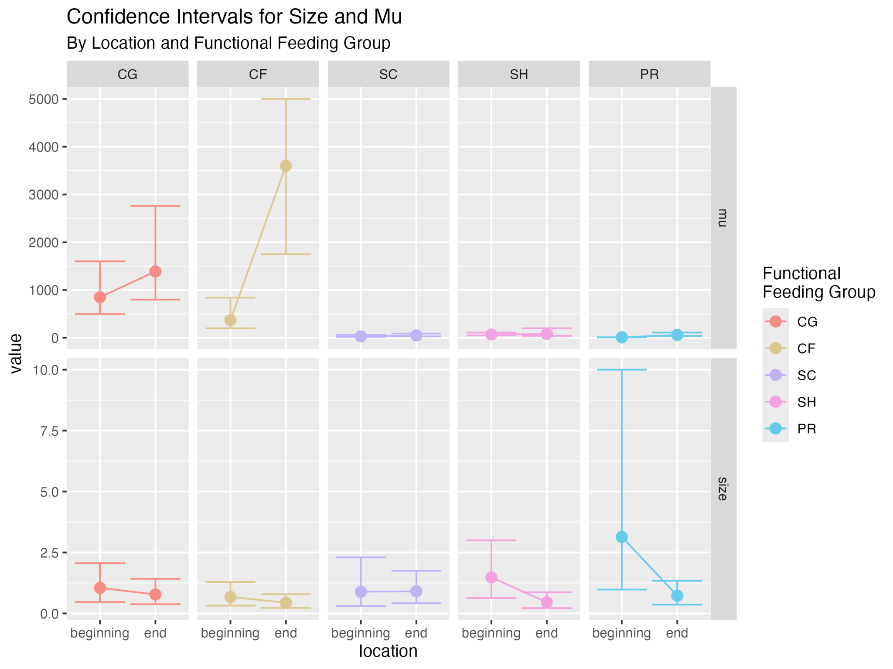
Negative Binomial
negative binomial parameters:
size: variance
mu: mean value
results:
size:
all overlap
no statistically significant difference
this is expected
mu:
significant difference in CF and PR

Slide 16
Thank you :)

